Slide 1
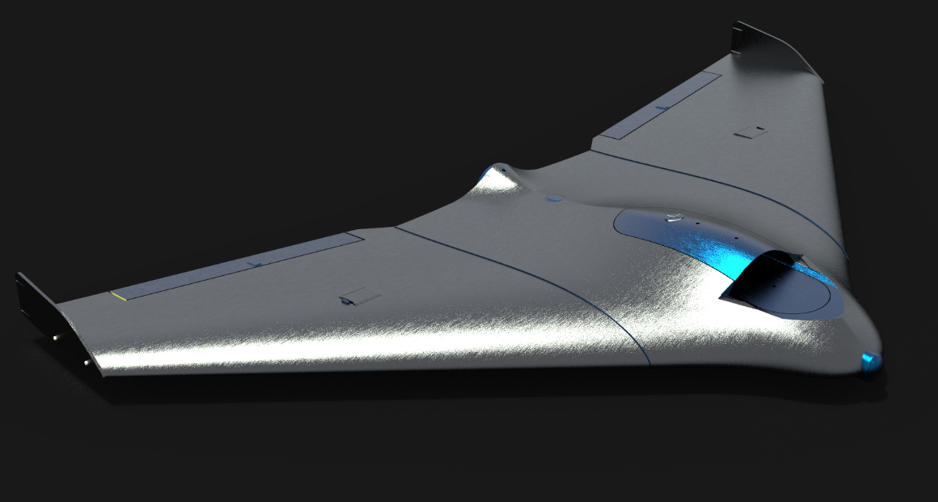
AUTONOMOUS FIXED WING UAV (Unmanned aerial Vehicle)
ADESH GREWAL
UE189005
PARAS NAITHANI
UE189055
Presentation

Slide 2
What is a UAV
A UAV is defined as an aerial vehicle that does not carry a human operator, it can fly automatically or drive remotely,it is regenerative and repurposable and can carry a deadly or non-lethal load. It is usually controlled by on-board computers autonomously or with remote driver control. Its use is currently limited by difficulties such as satellite communications and costs.

Slide 3
Our Aim
Our aim is to create a functional fixed wing autonomous UAV that can be controlled and send live visual feedback.
Our focus is to construct an autonomous fixed wing UAV system based on the matek microcontroller system focusing towards land surveillance. e.g such as monitoring flood-prone areas, recording video images from impassable areas as well as military and non-military security work.

Slide 4
Design
The Drone design chosen is a tailless swept back delta wing.
The dimensions are Wingspan: 1500mm
Root Chord : 250mm
Tip Chord : 150mm

Slide 5
Fuselage components
The components which are required for flying the plane are:
Motor
Airspeed sensor
GPS
Matek F405 -wing
1800 mah Battery
40 A ESC
Camera
Servos

Slide 6
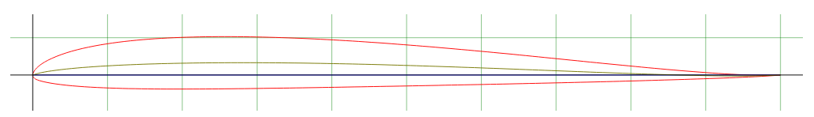
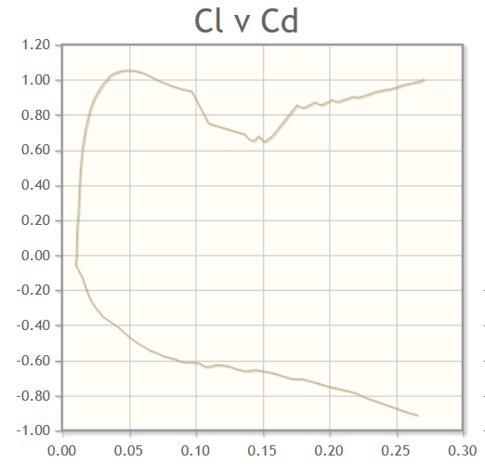
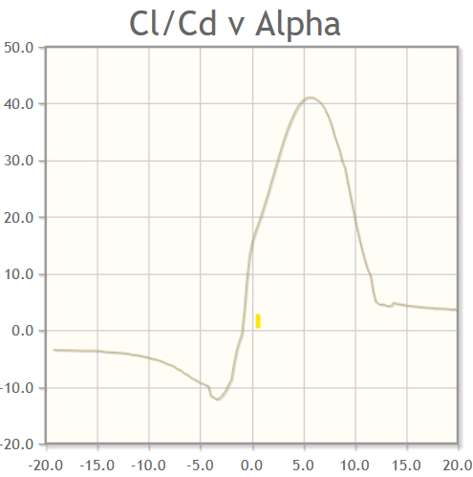
AirFoil Selection
The airfoil selected is PW1211. This airfoil was chosen because of it being thin and having a glider like characteristics with favourable drag and lift characteristics.
After reviewing the plots we have decided to keep AOA at 6°

Slide 7
Calculations
The estimated weight of the plane is 870g (with electronics weighing 500g).
Reynolds number: 1.1843e+5
Estimated lift: 3.305 N
Estimated static deflection : MAX - 30.34 mm

Slide 8
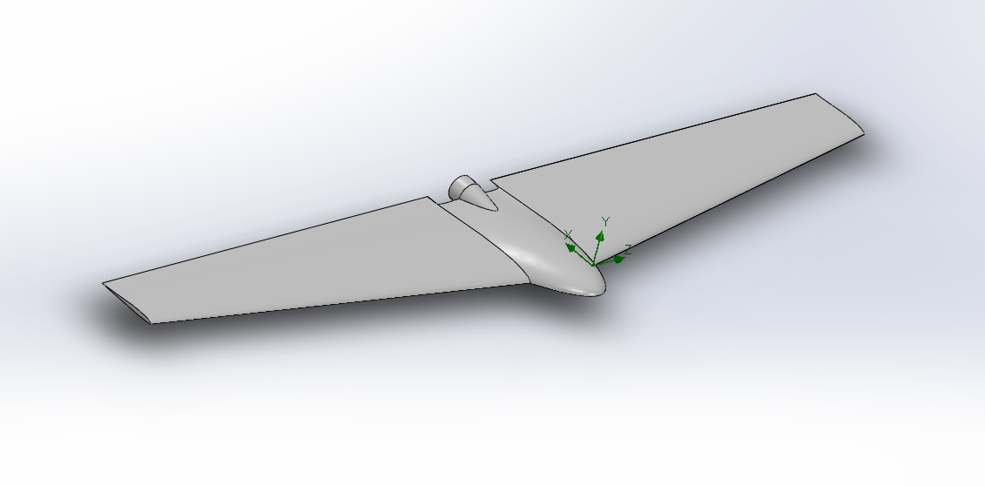
3D models and Simulations
CAD model of UAV

Slide 9
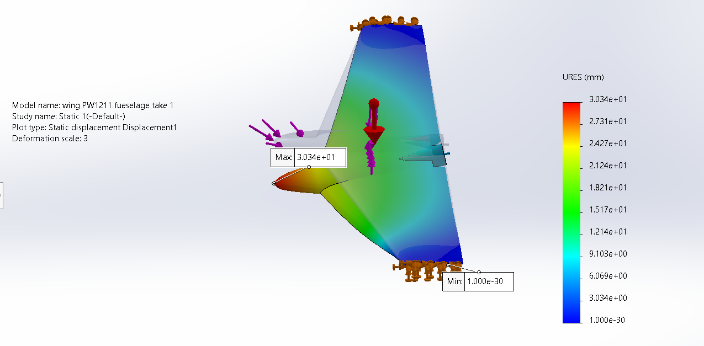
Static Deflection of UAV

Slide 10
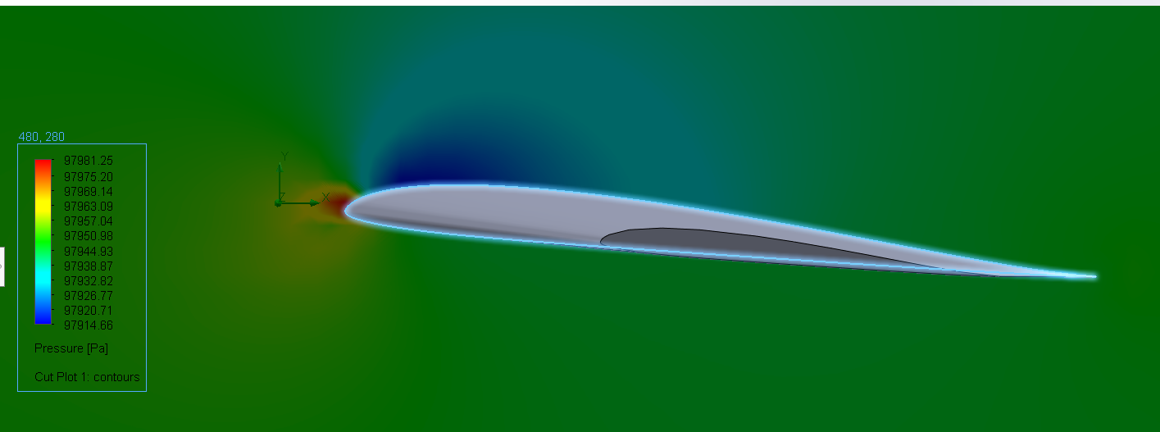
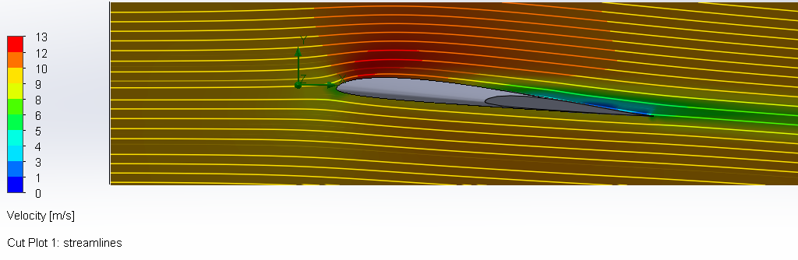
Wing Pressure Plot
Wing Velocity Plot

Slide 11
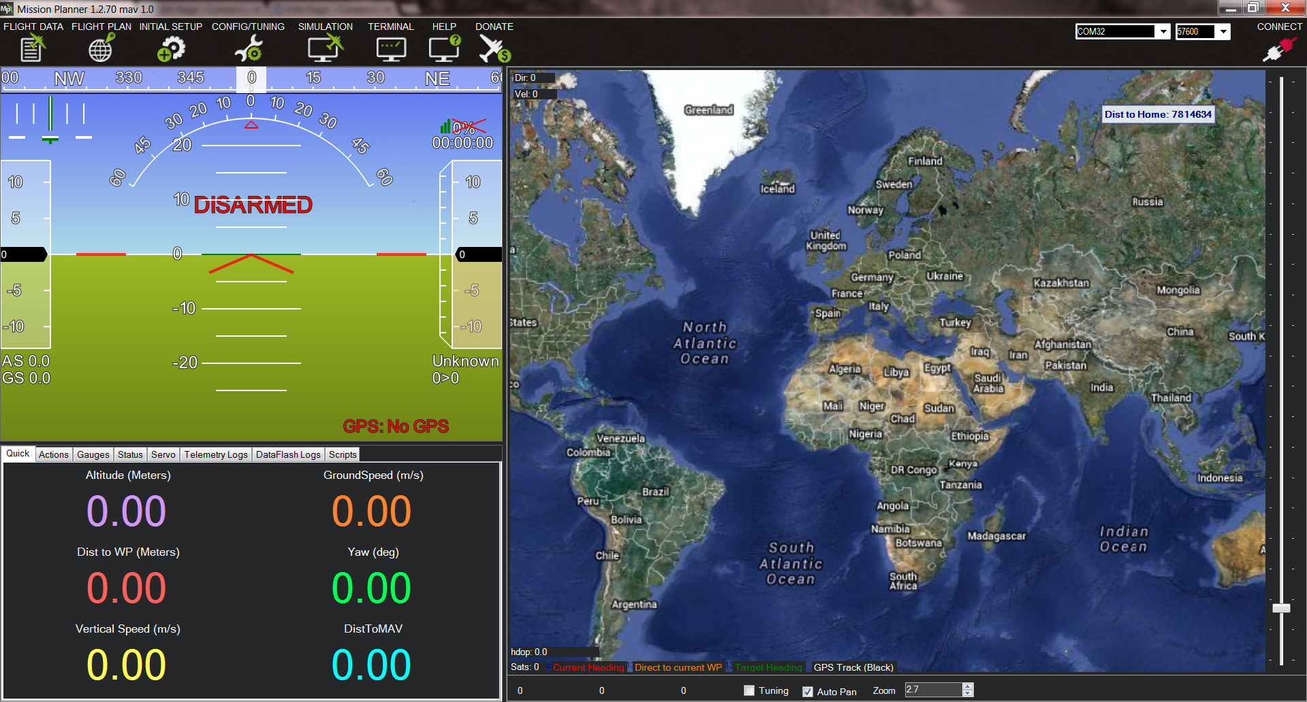
Software Used
Mission planner
ArduPilot

Slide 12
THANK YOU

